Slide 1

Programming Fundamental
Week 14
Sobia Iftikhar
Sobia.Iftikhar@nu.edu.pk

Slide 2
We’ll Learn Today
Introduction
Pointer Variable Definition & Initialization
Pointer Operators
Calling Function by Reference
Using const Qualifier in Pointers
Pointers & Arrays
Pointers & 2-Dimentional Arrays
Excercise

Slide 3
Introduction
Pointer are a fundamental part of C. If you cannot use pointers properly then you have basically lost all the power and flexibility that C allows. The secret to C is in its use of pointers.
C uses pointers a lot. Why?:
pass-by-reference,
to pass functions between functions, and
to create and manipulate dynamic data structures,
It is the only way to express some computations.
It produces compact and efficient code.
It provides a very powerful tool.
C uses pointers explicitly with:
Arrays,
Structures,
Functions.
NOTE: Pointers are perhaps the most difficult part of C to understand. C's implementation is slightly different DIFFERENT from other languages.

Slide 4
Pointer Variable Definitions and Initialization
Pointer variables
Contain memory addresses as their values
Normal variables contain a specific value (direct reference)
Pointers contain address of a variable that has a specific value (indirect reference)
Indirection – referencing a pointer value
count
7
countPtr
count
7

Slide 5
Pointer Variable Definitions and Initialization
Pointer definitions
* used with pointer variables
int *myPtr;
Defines a pointer to an int (pointer of type int *)
Multiple pointers require using a * before each variable definition
int *myPtr1, *myPtr2;
Can define pointers to any data type
Initialize pointers to 0, NULL, or an address
0 or NULL – points to nothing (NULL preferred)

Slide 6
Pointer Operators
& (address operator)
Returns address of operand
int y = 5;
int *yPtr;
yPtr = &y; /* yPtr gets address of y */
yPtr “points to” y
y
yptr
y
yPtr
5
500000
600000
600000
5
Address of y is value of yptr

Slide 7


Pointers?
A pointer is a variable whose value is the address of another variable, i.e., direct address of the memory location. Like any
variable or constant, you must declare a pointer before using it to store any variable address
int *p1;
int * p2;
You can also declare pointers in these ways.
int* p1, p2;
we have declared a pointer p1 and a normal variable p2.

Slide 8
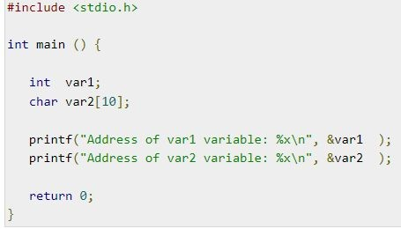

pointers

Slide 9

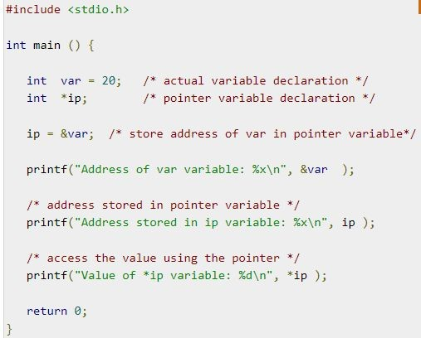

Pointers-Example

Slide 10
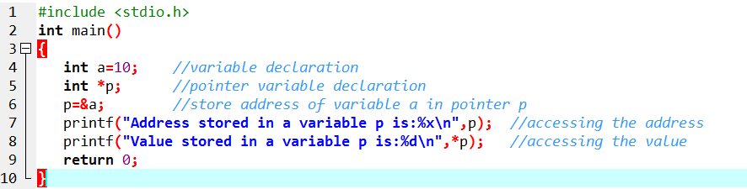
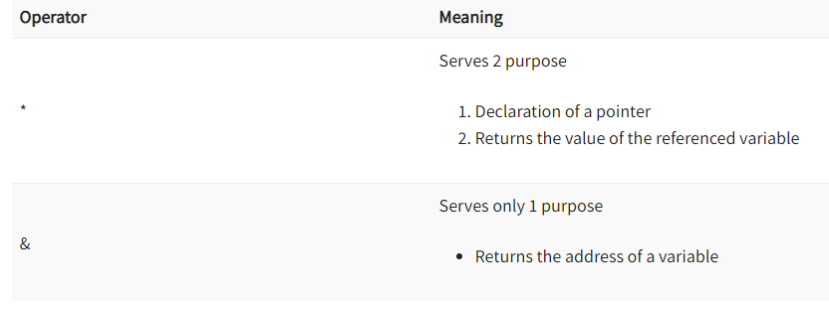
Example

Slide 11
Important Concepts(cont’d)
IMPORTANT:
When a pointer is declared it does not point anywhere. You must set it to point somewhere before you use it.
So ...
int *ip;
*ip = 100;
will generate an error (program crash!!).
The correct use is:
int *ip;
int x;
ip = &x;
*ip = 100;

Slide 12
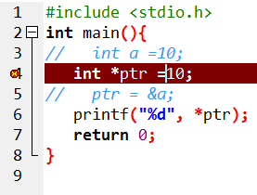
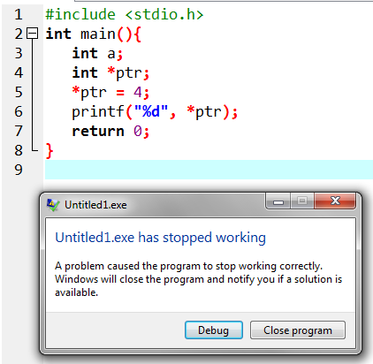
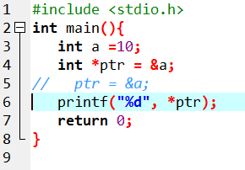
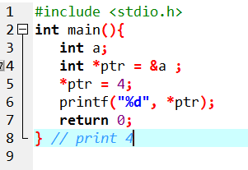
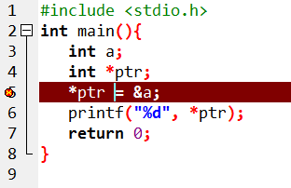
Important cases

Slide 13
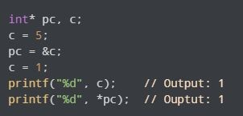
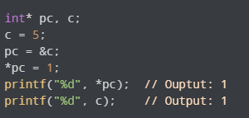
Changing Value Pointed by PointeR
We have assigned the address of c to the pc pointer.
Then, we changed the value of c to 1. Since pc and the address of c is the same, *pc gives us 1.
We have assigned the address of c to the pc pointer.
Then, we changed *pc to 1 using *pc = 1;. Since pc and the address of c is the same, c will be equal to 1.

Slide 14
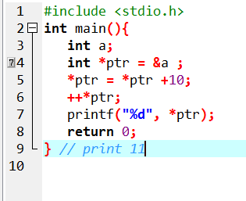
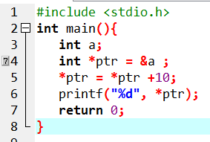
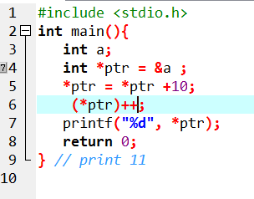
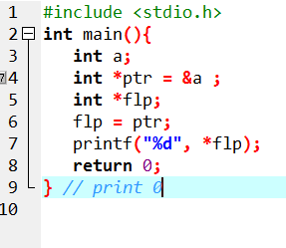
Important Concepts(cont’d)
We can do integer arithmetic on a pointer:
float *flp, *flq;
*flp = *flp + 10;
++*flp;
(*flp)++;
flq = flp;
.

Slide 15
Simple Example
void main(void)
{
int a,b;
int *pa, *pb;
a=5; b=10;
pa=&a; pb=&b;
*pa = *pa +10;
*pb = *pb +10;
printf(“ %d “, a);
printf(“\n %d “,b);
}

Slide 16
Another Example
void main(void)
{
int I, *p1, **p2;
i=5;
p1 = &I;
p2 = &p1;
pirntf(“ %d “, **p2 );
printf(“ %d “, * p1);
}
What will be the output??????

Slide 17
Calling Functions by Reference
Call by reference with pointer arguments
Pass address of argument using & operator
Allows you to change actual location in memory
Arrays are not passed with & because the array name is already a pointer
* operator
Used as alias/nickname for variable inside of function
void double( int *number )
{
*number = 2 * ( *number );
}
*number used as nickname for the variable passed

Slide 18
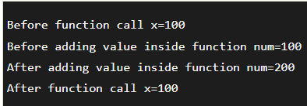
Conceptual Example (Call-by-Value)
#include<stdio.h>
void change(int num) {
printf("Before adding value inside function num=%d \n",num);
num=num+100;
printf("After adding value inside function num=%d \n", num);
}
int main() {
int x=100;
printf("Before function call x=%d \n", x);
change(x);//passing value in function
printf("After function call x=%d \n", x);
return 0;
}

Slide 19
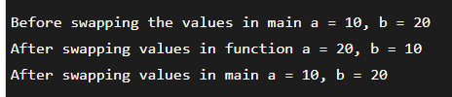
Conceptual Example (Call-by-Value)
#include <stdio.h>
void swap(int , int); //prototype of the function
int main()
{
int a = 10;
int b = 20;
printf("Before swapping the values in main a = %d, b = %d\n",a,b); // printing the value of a and b in main
swap(a,b);
printf("After swapping values in main a = %d, b = %d\n",a,b); // The value of actual parameters do not change by changing the formal parameters in call by value, a = 10, b = 20
}
void swap (int a, int b)
{
int temp;
temp = a;
a=b;
b=temp;
printf("After swapping values in function a = %d, b = %d\n",a,b); // Formal parameters, a = 20, b = 10
}

Slide 20
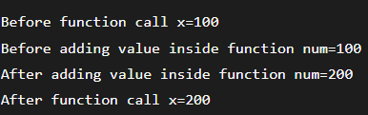
Conceptual Example (Call-by-Reference)
#include<stdio.h>
void change(int *num) {
printf("Before adding value inside function num=%d \n",*num);
(*num) += 100;
printf("After adding value inside function num=%d \n", *num);
}
int main() {
int x=100;
printf("Before function call x=%d \n", x);
change(&x);//passing reference in function
printf("After function call x=%d \n", x);
return 0;
}

Slide 21

Conceptual Example (Call-by-Reference)
#include <stdio.h>
void swap(int *, int *); //prototype of the function
int main()
{
int a = 10;
int b = 20;
printf("Before swapping the values in main a = %d, b = %d\n",a,b); // printing the value of a and b in main
swap(&a,&b);
printf("After swapping values in main a = %d, b = %d\n",a,b); // The values of actual parameters do change in call by reference, a = 10, b = 20
}
void swap (int *a, int *b)
{
int temp;
temp = *a;
*a=*b;
*b=temp;
printf("After swapping values in function a = %d, b = %d\n",*a,*b); // Formal parameters, a = 20, b = 10
}

Slide 22
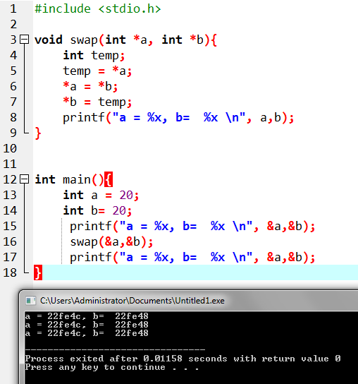
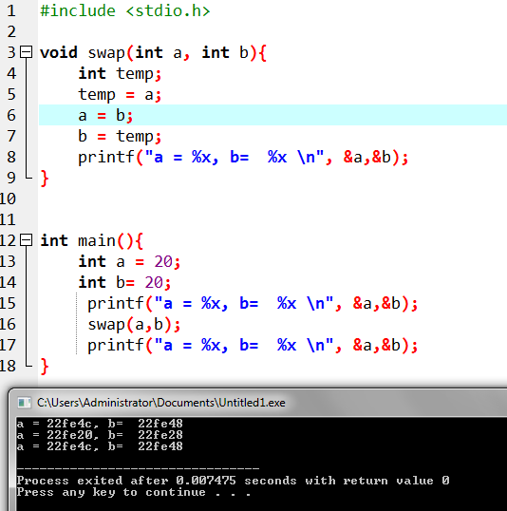

Slide 23

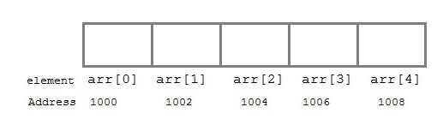
Pointer to Array
Variable arr will give the base address, which is a constant pointer pointing to arr[0]. Hence arr contains the address of arr[0] i.e 1000.
arr has two purpose -
It is the name of the array
It acts as a pointer pointing towards the first element in the array.
arr is equal to &arr[0] by default

Slide 24
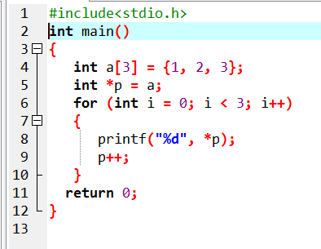

Example

Slide 25
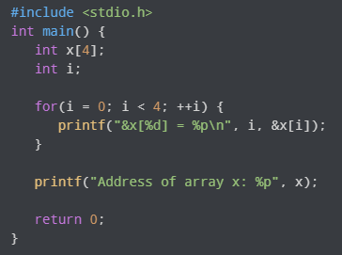

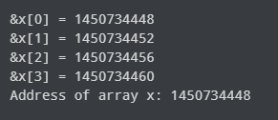
Relationship Between Arrays and Pointers
Notice that, the address of &x[0] and x is the same. It's because the variable name x points to the first element of the array.

Slide 26
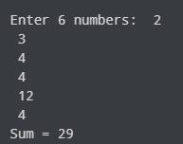
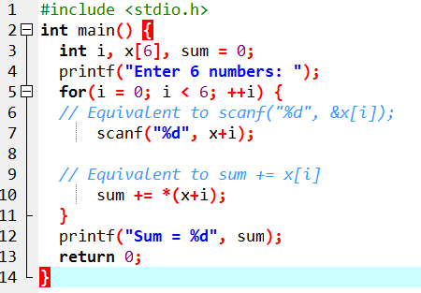
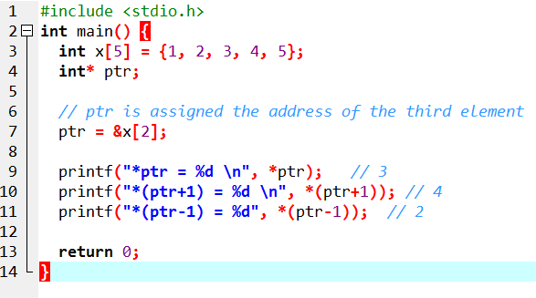
Relationship Between Arrays and Pointers
&x[1] is equivalent to x+1 and x[1] is equivalent to *(x+1).
&x[2] is equivalent to x+2 and x[2] is equivalent to *(x+2).
Basically, &x[i] is equivalent to x+i and x[i] is equivalent to *(x+i).

Slide 27
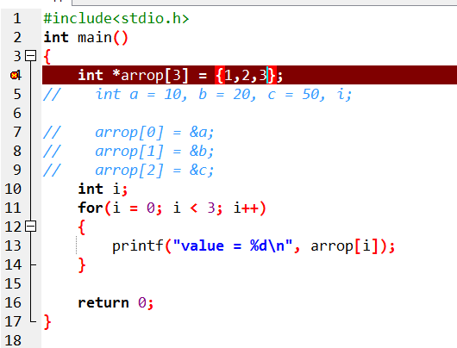
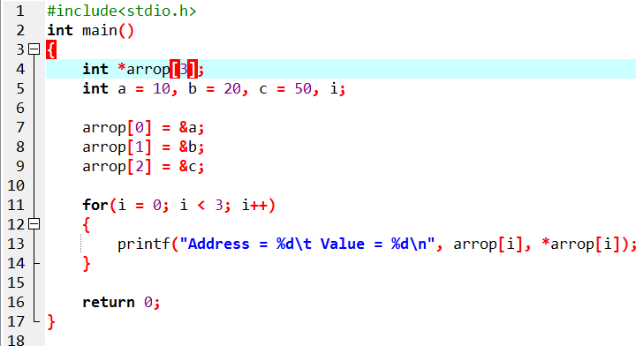
Array of Pointer

Slide 28
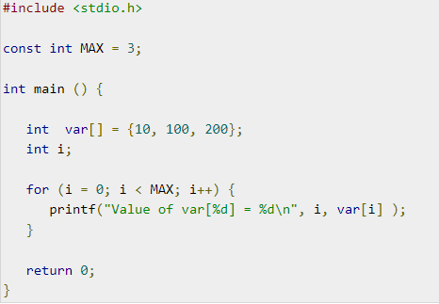
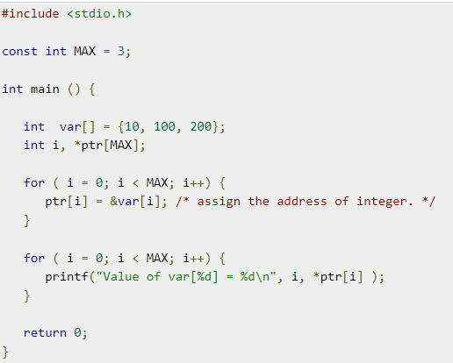


Array of Pointer

Slide 29
Void Pointer
we cannot assign the address of a variable of one data type to a pointer of another data type. Consider this example:
// pointer is of int type
int *ptr;
// variable is of double type
double d = 9.0;
// Error
// can't assign double* to int*
ptr = &d;
the error occurred because the address is a double type variable. However, the pointer is of int type.

Slide 30
Void Pointer
// void pointer
void *ptr;
double d = 9.0;
// valid code
ptr = &d
The void pointer is a generic pointer that is used when we don't know the data type of the variable that the pointer points to.

Slide 31
Example
#include <iostream>
using namespace std;
int main() {
void* ptr;
float f = 2.3f;
// assign float address to void
ptr = &f;
cout << &f << endl;
cout << ptr << endl;
return 0;
}
0xffd117ac
0xffd117ac

Slide 32
Void pointer
As void is an empty type, void pointers cannot be dereferenced.
void* ptr;
float* fptr;
float f = 2.3;
// assign float address to void pointer
ptr = &f;
cout << *ptr << endl; // Error
// assign float address to float pointer
fptr = &f;
cout << *fptr << endl; // Valid

Slide 33
Example 2: Printing the Content of Void Pointer
#include <iostream>
using namespace std;
int main() {
void* ptr;
float f = 2.3f;
// assign float address to void pointer
ptr = &f;
cout << "The content of pointer is ";
// use type casting to print pointer content
cout << *(static_cast<float*>(ptr));
return 0;
}
The content of pointer is 2.3
we have used the static_cast operator to convert the data type of the pointer from void* to float*.

Slide 34
Dynamic Memory (DMA)
The process of allocating memory during program execution is called dynamic memory allocation. The ability for a program to obtain more memory space at execution time to hold new nodes, and to release space no longer needed is known as dynamic memory management.
Many times, it is not known in advance how much memory will be needed to store particular information in a defined variable and the size of required memory can be determined at run time

Slide 35
dynamic memory allocation functions
Function | Syntax
malloc () | malloc (number *sizeof(int));
calloc () | calloc (number, sizeof(int));
realloc () | realloc (pointer_name, number * sizeof(int));
free () | free (pointer_name);

Slide 36
Malloc() function in C
The C malloc() function stands for memory allocation. It is a function which is used to allocate a block of memory dynamically. It reserves memory space of specified size and returns the null pointer pointing to the memory location. The pointer returned is usually of type void. It means that we can assign C malloc() function to any pointer.
Syntax of malloc() Function:
ptr = (cast_type *) malloc (byte_size);
ptr is a pointer of cast_type.
The C malloc() function returns a pointer to the allocated memory of byte_size.
Example of malloc():
Example: ptr = (int *) malloc (50)
When this statement is successfully executed, a memory space of 50 bytes is reserved. The address of the first byte of reserved space is assigned to the pointer ptr of type int

Slide 37
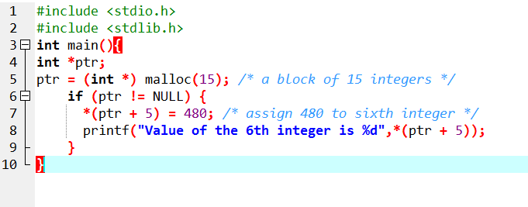
Malloc() function in C

Slide 38
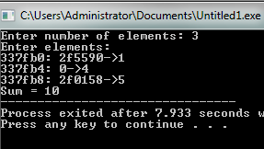
Malloc()
#include <stdio.h>
#include <stdlib.h>
int main() {
int n, i, *ptr, sum = 0;
printf("Enter number of elements: ");
scanf("%d", &n);
ptr = (int*) malloc(n* sizeof(int));
if(ptr == NULL) {
printf("Error! memory not allocated.");
exit(0);
}
printf("Enter elements:\n");
for(i = 0; i < n; ++i) {
printf("%x: ", ptr + i);
printf("%x->", *(ptr + i));
scanf("%d", ptr + i);
sum += *(ptr + i);
}
printf("Sum = %d", sum);
// deallocating the memory
free(ptr);
return 0;
}
calloc function is also like malloc function. But calloc initializes the allocated memory to zero. But, malloc doesn’t.

Slide 39
Calloc() function in C
The C calloc() function stands for contiguous allocation. This function is used to allocate multiple blocks of memory. It is a dynamic memory allocation function which is used to allocate the memory to complex data structures such as arrays and structures.
Malloc() function is used to allocate a single block of memory space while the calloc() in C is used to allocate multiple blocks of memory space. Each block allocated by the calloc() function is of the same size..
Syntax of calloc() Function:
ptr = (cast_type *) calloc (n, size);
The above statement is used to allocate n memory blocks of the same size.
After the memory space is allocated, then all the bytes are initialized to zero.
The pointer which is currently at the first byte of the allocated memory space is returned.

Slide 40
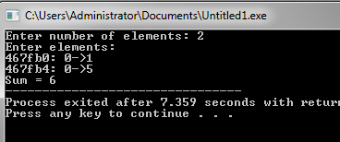
Calloc()
#include <stdio.h>
#include <stdlib.h>
int main() {
int n, i, *ptr, sum = 0;
printf("Enter number of elements: ");
scanf("%d", &n);
ptr = (int*) calloc(n, sizeof(int));
if(ptr == NULL) {
printf("Error! memory not allocated.");
exit(0);
}
printf("Enter elements:\n");
for(i = 0; i < n; ++i) {
printf("%x: ", ptr + i);
printf("%x->", *(ptr + i));
scanf("%d", ptr + i);
sum += *(ptr + i);
}
printf("Sum = %d", sum);
// deallocating the memory
free(ptr);
return 0;
}
malloc function is used to allocate space in memory during the execution of the program.
malloc does not initialize the memory allocated during execution. It carries garbage value.
Malloc function returns null pointer if it couldn’t able to allocate requested amount of memor

Slide 41
Realloc()
#include <stdio.h>
#include <stdlib.h>
int main() {
int *ptr, i , n1, n2;
printf("Enter size: ");
scanf("%d", &n1);
ptr = (int*) malloc(n1 * sizeof(int));
printf("Addresses of previously allocated memory:\n");
for(i = 0; i < n1; ++i)
printf("%pc\n",ptr + i);
printf("\nEnter the new size: ");
scanf("%d", &n2);
// rellocating the memory
ptr = realloc(ptr, n2 * sizeof(int));
printf("Addresses of newly allocated memory:\n");
for(i = 0; i < n2; ++i)
printf("%pc\n", ptr + i);
free(ptr);
return 0;
}
realloc function modifies the allocated memory size by malloc and calloc functions to new size.
If enough space doesn’t exist in memory of current block to extend, new block is allocated for the full size of reallocation, then copies the existing data to new block and then frees the old block.
Enter size: 2
Addresses of previously allocated memory:
26855472
26855476
Enter the new size: 4
Addresses of newly allocated memory:
26855472
26855476
26855480
26855484

Slide 42
Thankyou

